Slide 1
Science
Education Center
Here is where your presentation begins

Slide 2
Contents of This Template
Here’s what you’ll find in this Slidesgo template:
A slide structure based on a school center, which you can easily adapt to your needs. For more info on how to edit the template, please visit Slidesgo School or read our FAQs.
An assortment of illustrations that are suitable for use in the presentation can be found in the alternative resources slide.
A thanks slide, which you must keep so that proper credits for our design are given.
A resources slide, where you’ll find links to all the elements used in the template.
Instructions for use and final slides with:
The fonts and colors used in the template.
A selection of illustrations. You can also customize and animate them as you wish with the online editor. Visit Stories by Freepik to find more.
More infographic resources, whose size and color can be edited.
Sets of customizable icons of the following themes: general, business, avatar, creative process, education, help & support, medical, nature, performing arts, SEO & marketing, and teamwork.
You can delete this slide when you’re done editing the presentation.

Slide 3
Table of Contents
01
02
03
04
Teaching Method
Academic Areas
Our
Teachers
Enrollment Process
Here you could describe the topic of the section
Here you could describe the topic of the section
Here you could describe the topic of the section
Here you could describe the topic of the section

Slide 4
01
Teaching Method
You could enter a subtitle here if you need it

Slide 5
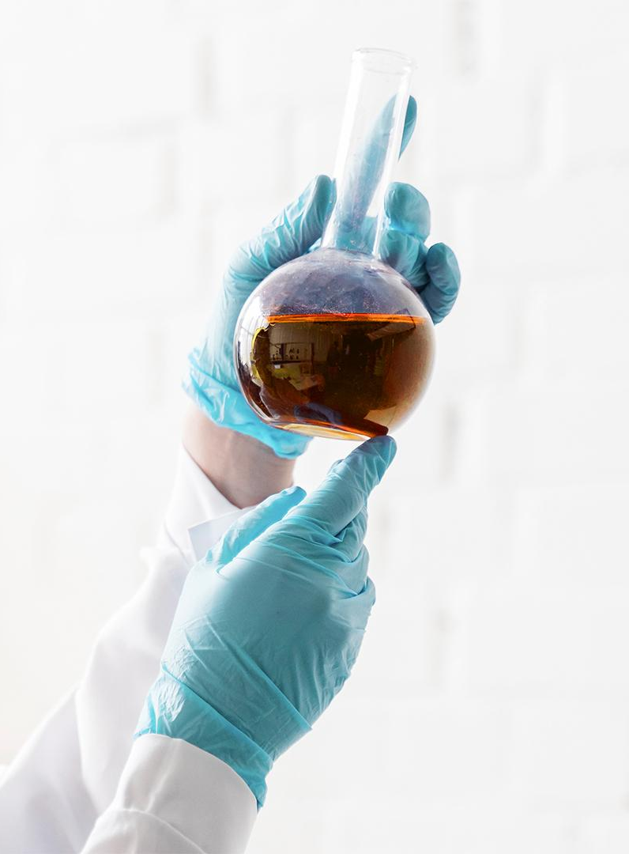

Introduction
Jupiter is the biggest planet in the Solar System and the fourth-brightest object in the night sky

Slide 6
“
—Someone Famous
This is a quote. Words full of wisdom that someone important said and can make the reader get inspired.”

Slide 7
Our Teaching Method
Feedback & Evaluation
Activities
Goals
Saturn is composed mostly of hydrogen and helium
Despite being red, Mars is a cold place full of iron oxide dust
Jupiter is a gas giant and the biggest planet in the Solar System

Slide 8
What Sets Us Apart
Mercury
Neptune
Mars
Despite being red, Mars is actually a cold place full of iron oxide dust
Neptune is the fourth-largest planet in the Solar System
Jupiter is a gas giant and the biggest planet in the Solar System

Slide 9
The Curriculum
Initial
Advanced
Content 1
Content 2
Content 3
Content 4
Content 5
Content 6
60%
40%

Slide 10
Academic Areas
Mars
Venus
Mercury
Jupiter
Saturn
Neptune
Mars is actually a cold place
Venus is the second planet from the Sun
It’s the closest planet to the Sun
It’s the biggest planet of them all
Saturn is a gas giant and has rings
It’s the farthest planet from the Sun

Slide 11
Our Mission and Vision
Mission
Vision
Mercury is the closest planet to the Sun and the smallest one in the Solar System
Venus has a beautiful name and is the second planet from the Sun. It’s terribly hot

Slide 12
Our Values
Loyalty
Efficiency
Reliability
Commitment
Mercury is a bit larger than the Moon
Despite being red, Mars is actually a cold place
Venus is the second planet from the Sun
Neptune the farthest planet from the Sun

Slide 13
Our Success
800K
900K
Despite being red, Mars is actually a cold planet
Saturn is composed of hydrogen and helium

Slide 14
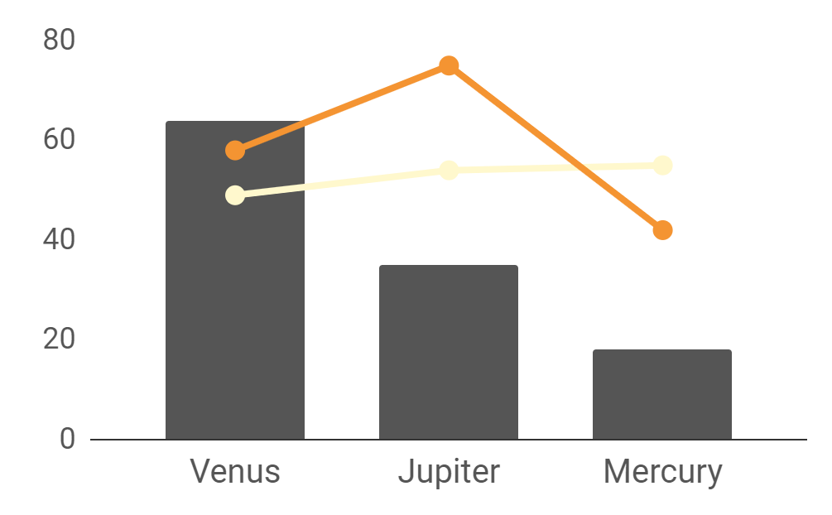
Statistics
54%
78%
Saturn stats
Neptune stats
To modify this graph, click on it, follow the link, change the data and paste it here

Slide 15
Students Around the World
This is a map where you can mark the size of your audience
Jupiter is the biggest planet in the Solar System and the fourth-brightest object in the night sky

Slide 16
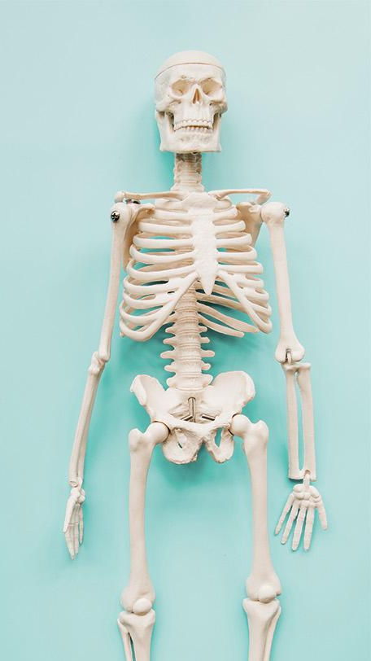
Our Teachers
John James
Jenna Doe
Jane Patt
You can talk about the actions here
You can talk about the actions here
You can talk about the actions here

Slide 17
Saturn
Mars
Our Goals
Jupiter
Neptune
Venus
Pluto
It has several rings
It’s a cold place
It’s the biggest one
It’s the farthest one
It’s quite hot
It’s a dwarf planet

Slide 18
Student Process
1st Term
2nd Term
3rd Term
4th Term
Mercury is the smallest planet
Jupiter is the biggest planet
Despite being red, Mars is a cold place
Saturn is a gas giant and has rings

Slide 19
Enrollment Process
1st | Process | You could state one of your enrollment processes here
2nd | Process | You could state one of your enrollment processes here
3rd | Process | You could state one of your enrollment processes here
4th | Process | You could state one of your enrollment processes here

Slide 20
Special Reminders
Saturn is composed of hydrogen and helium
Jupiter is the biggest planet of them all
Despite being red, Mars is a cold place
Mercury is the closest planet to the Sun

Slide 21
Thanks!
Do you have any questions?
youremail@freepik.com
+91 620 421 838
yourcompany.com
Please keep this slide for attribution.

